Slide 1
HYBRID CLOUD SERVICE
Sprint 1 demo : Feb 9, 2016
-Akash Singh
-Jaison Babu
-Surekha Jadhwani
-Vignesh Shanmuganathan
Mentor: Xu(Simon) Chen

Slide 2
Project Overview:
Goals
  Develop an hybrid cloud model that allows application to support data processing in either private or public or both clouds with seamless data distribution.
  Easy user configuration to identify sensitive and non-sensitive data.
  Data segregation of live twitter feed using tagging mechanism that allows distribution of data between private and public cloud.
  Performance benchmarking of data analysis jobs between private, public and hybrid cloud.

Slide 3
Project Overview(cont’d):
Users
  Companies with private cloud wishing to incorporate public cloud infrastructure without compromising data security.
  Software developers who can make use of the combined public and private cloud.
  Researchers of hybrid cloud computing model.

Slide 4
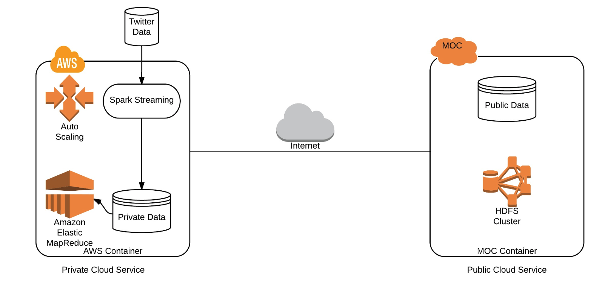
Architecture:

Slide 5
Sprint 1 planning: Feb 9
User story covered:
  As a user , one must be able to retrieve live twitter feed and view sensitive data locally
    Set-up a private cloud in AWS and public cloud in Massachusetts Open Cloud
    Install Hadoop on AWS and MOC.
    Configure spark streaming job that consumes twitter live feed on local machine.
    Configure tags to identify sensitive data
    Create a parser algorithm that partitions the consumed data into sensitive and non-sensitive data based on twitter tags on local machine.

Slide 6
Problems Faced:
Establishing SSH connection to MOC machine:
  Generate key-pair and assign to individual machine while creating VM and export to local machine and convert to putty format using Putty Generator.
  No internet access on Ubuntu VM during spark installation:
  Update /etc/resol.conf with appropriate server detail.
  Packaging and deploying spark streaming application:
  Created build.sbt to add dependant jar files.
  Filtering twitter feeds based on user configuration from live stream:
  Used Java lambda functions to filter twitter Status object and then mapped the filter Status object Collection to retrieve twitter feed text.
  Working on migration of twiter4j library to the filter data based on language

Slide 7
Plan for Sprint 2: Feb 23
User story planned:
  As a user , one must be able to store his sensitive data in a secure cloud service and non-sensitive data in a public cloud service.
    Install Hadoop on AWS and MOC in multi node cluster mode.
    Establish communication between MOC cluster and AWS cluster.
    Configure spark streaming job in private cloud that consumes twitter live feed on AWS Hadoop cluster.
    Extend the parser algorithm that partitions the consumed data into private and public based on twitter tags

Slide 8
DEMO

Slide 9
Questions?

Slide 10
Thank You

